Slide 1
Anyone Can Code-Mesh:
Teaching and Tutoring Strategies for
The First-Year Writing Classroom
WHITNEY GEGG-HARRISON
SARAH LEMADE
STELLA WANG
SUZANNE WOODRING
2017 CCCC Convention
March 16, 2017
Notes:
Title slide: Intro

Slide 2
Overview
What is code-meshing?
Why teach code-meshing in first-year writing courses?
How to incorporate code-meshing in our classrooms?
  Structured class discussions
  Formal/informal assignments around code-meshing
  Tutoring strategies
Notes:
Stella: Overview

Slide 3
What is code-meshing?
Controversy: Is it code-switching or code-meshing?
Definitions:
code-switching
    shifts between multiple languages, local varieties, or registers
Notes:
Whitney: Definition of code-switching

Slide 4
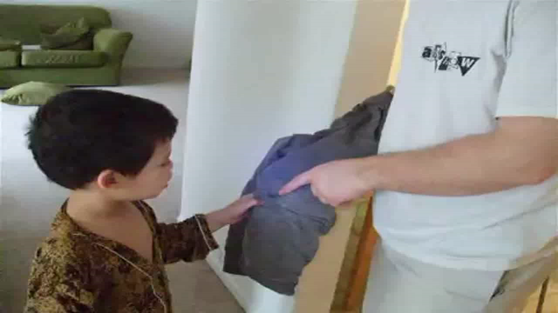
Code-Switching: between INDONESIAN, ENGLISH, AND FRENCH
Notes:
Whitney: The multilingual child/Code-switching video

Slide 5
What is code-meshing?
Controversy: Is it code-switching or code-meshing?
Definitions:
code-switching
    shifts between multiple languages, local varieties, or registers
code-meshing
Notes:
Suzanne: What is code-meshing? First Key and Peele, followed by definition

Slide 6

Key & Peele: Phone Call
Notes:
Suzanne: Key & Peele
Suzanne’s explanation of code-meshing and Key and Peele example to go with it.
Key and Peele’s specific reasons for meshing dialects is probably obvious to you.
So, why we talking about code-meshing and taking initiatives to incorporate meshing opportunities in our first year writing classrooms? (next slide)

Slide 7
What is code-meshing?
Controversy: Is it code-switching or code-meshing?
Definitions:
code-switching
    shifts between multiple languages, local varieties, or registers
code-meshing
    blends languages, local varieties, or registers with a dominant language
    tends to be a purposeful, rhetorical strategy
Notes:
Suzanne: What is code-meshing? Definition of code-meshing

Slide 8
What is code-meshing?
Our observations:
    Both code-switching and code-meshing can involve multiple local and global languages
Notes:
Whitney and Suzanne: Our observations

Slide 9
What is code-meshing?
Our observations:
    Both code-switching and code-meshing can involve multiple local and global languages
    Code-meshing is a deliberate, rhetorical move made by the author
Notes:
Whitney and Suzanne: Our observations

Slide 10
What is code-meshing?
Our observations:
    Both code-switching and code-meshing can involve multiple local and global languages
    Code-meshing is a deliberate, rhetorical move made by the author
    As such, code-meshing is highly relevant to writing and writing pedagogy
Notes:
Whitney and Suzanne: Our observations

Slide 11
Why teach code-meshing?
The writing classroom is changing:
Demographic shifts in American schools, universities, workplace, and society at large
    Moss and Walters (1993): "no single ethnic group will constitute the majority of Americans: instead, the majority will soon be composed of various groups of ethnic minorities"
Notes:
Stella: Code-meshing and the changing wrting classroom > pedagogical challenges and goals

Slide 12
Why teach code-meshing?
The writing classroom is changing:
Demographic shifts in American schools, universities, workplace, and society at large
    Moss and Walters (1993): "no single ethnic group will constitute the majority of Americans: instead, the majority will soon be composed of various groups of ethnic minorities."
Students’ right to their own language (NCTE 1974)
Council of Writing Program Administrators: outcome statements for first-year composition (2014)
Notes:
Stella: Code-meshing and the changing wrting classroom > pedagogical challenges and goals

Slide 13
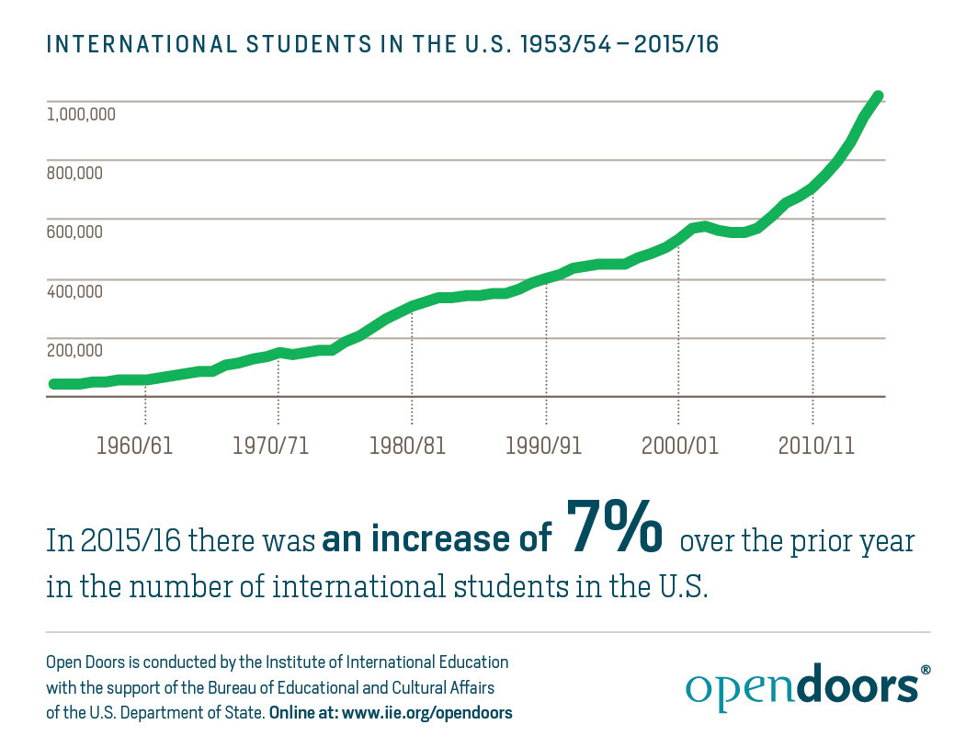

Why teach code-meshing?
The writing
classroom is
changing:
Institute of International Education (IIE)
Notes:
Stella: Code-meshing and the changing wrting classroom > pedagogical challenges and goals

Slide 14
Why teach code-meshing?
The writing classroom is changing:
The third culture kids (Pollock and Van Reken, 2009)
Multilinguals: global and domestic (Grosjean, 2012)
College statistics (UR 2016)
Higher education and global engagement
Notes:
Stella: Code-meshing and the changing wrting classroom > pedagogical challenges and goals

Slide 15
Why teach code-meshing?
We can help students think about:
The social, political, and cultural features of spoken and written language (Shafer, 2007)
Their perceptions of race and power and how these are connected to linguistic choices (Baugh, 2000)
Their own diverse linguistic and cultural identities
Linguistic risks and assumptions about ‘good’ and ‘bad’ writing
Notes:
Suzanne: Why teach code-meshing?

Slide 16
How do we teach code-meshing?
We design pilot lessons and writing assignments to support students’ investigations of how code-meshing occurs within and beyond the writing classroom:
Notes:
Whitney: How do we teaching code-meshing?

Slide 17
How do we teach code-meshing?
We design pilot lessons and writing assignments to support students’ investigations of how code-meshing occurs within and beyond the writing classroom:
Code-meshing as something that arises organically in the classroom:
    courses centered on culture
    courses centered on language
Notes:
Whitney: How do we teaching code-meshing?

Slide 18
How do we teach code-meshing?
We design pilot lessons and writing assignments to support students’ investigations of how code-meshing occurs within and beyond the writing classroom:
Code-meshing as something that arises organically in the classroom:
    courses centered on culture
    courses centered on language
Academic code-meshing as a unit
    an integral part of the final research project
    applicable to a wide range of theme-based writing courses
Notes:
Whitney: How do we teaching code-meshing?

Slide 19
Suzanne: Considering Audience and Teaching Culture through Informal, Code-meshing Opportunities
Student assumptions
  Value – ‘good’ versus ‘bad’ writing
  Approach – transferable writing skills
  Purpose – the audience’s needs
Notes:
Suzanne: Begin by disucssion how I went about teaching code meshing and a little about our initiative as the code-meshing committee if not too much of a repeat from others.
When we as a committee were charged with figuring out what code-meshing actually is (as it relates to us as writing instructors), we piloted lessons, activities in the classroom. This sparked conversation out of some confusion at first. Students wanted to know why we were doing this (and how they would be graded). I learned a lot about their needs, expectations, and assumptions.
Course content relates to the differences in learning between cultures - some examples, some expect children to learn through imitation, so focus on explicit instruction
Different cultures value aspects of intelligence to varying degrees or intelligence does not carry a universal definition
Something about different needs (this transitions into the differing needs of different audiences)
Then something about how different audiences have different needs
Still trying to figure out how to best design assignment prompts and informal writing. I still have questions. A student last semester wanted to know how I was going to be able to grade his paper if he meshed English with Chinese since I don’t speak Chinese. Another student intersted in computer science wanted to incorporate computer code into his final paper.
‘I’m really bad at writing’ - based on prior writing experiences
complex sentence structures and big words make good writing
For students where English is not their first language - leave native language at the door, no use for native language or dialect in the classroom
Their audience is the teacher, the one grading
Audience = purpose; if they aren’t writing to a real audience, then there is no real purpose
Course content relates to the differences in learning between cultures - some examples, some expect children to learn through imitation, so focus on explicit instruction
Different cultures value aspects of intelligence to varying degrees or intelligence does not carry a universal definition
Something about different needs (this transitions into the differing needs of different audiences)
Then something about how different audiences have different needs
Example assignment: Writing for Different Audiences (4 parts)
Tell 3 different audiences about your research topic (after they’ve done some research)
Come up with a scenario (and define your purpose) - imagine you had to put 2 of your audiences in the same room and still make your point clear to all - now the task is that much more difficult because you have to meet the needs of each audience and maybe even address the point for why they are in the same room (in your writing)
Write about your topic again, this time making sure you are meeting the needs of your new audience (*some students choose to code-mesh and others do not - make the point here about not making code-meshing mandatory, but giving them the option).
Peer Review - Is the purpose clear? Has the writer made reasonable linguistic choices?

Slide 20
Suzanne: Considering Audience and Teaching Culture through Informal, Code-meshing Opportunities
A scaffolded approach
Considering audience
Notes:
Suzanne: Begin by disucssion how I went about teaching code meshing and a little about our initiative as the code-meshing committee if not too much of a repeat from others.
When we as a committee were charged with figuring out what code-meshing actually is (as it relates to us as writing instructors), we piloted lessons, activities in the classroom. This sparked conversation out of some confusion at first. Students wanted to know why we were doing this (and how they would be graded). I learned a lot about their needs, expectations, and assumptions.
Course content relates to the differences in learning between cultures - some examples, some expect children to learn through imitation, so focus on explicit instruction
Different cultures value aspects of intelligence to varying degrees or intelligence does not carry a universal definition
Something about different needs (this transitions into the differing needs of different audiences)
Then something about how different audiences have different needs
Still trying to figure out how to best design assignment prompts and informal writing. I still have questions. A student last semester wanted to know how I was going to be able to grade his paper if he meshed English with Chinese since I don’t speak Chinese. Another student intersted in computer science wanted to incorporate computer code into his final paper.
‘I’m really bad at writing’ - based on prior writing experiences
complex sentence structures and big words make good writing
For students where English is not their first language - leave native language at the door, no use for native language or dialect in the classroom
Their audience is the teacher, the one grading
Audience = purpose; if they aren’t writing to a real audience, then there is no real purpose
Course content relates to the differences in learning between cultures - some examples, some expect children to learn through imitation, so focus on explicit instruction
Different cultures value aspects of intelligence to varying degrees or intelligence does not carry a universal definition
Something about different needs (this transitions into the differing needs of different audiences)
Then something about how different audiences have different needs
Example assignment: Writing for Different Audiences (4 parts)
Tell 3 different audiences about your research topic (after they’ve done some research)
Come up with a scenario (and define your purpose) - imagine you had to put 2 of your audiences in the same room and still make your point clear to all - now the task is that much more difficult because you have to meet the needs of each audience and maybe even address the point for why they are in the same room (in your writing)
Write about your topic again, this time making sure you are meeting the needs of your new audience (*some students choose to code-mesh and others do not - make the point here about not making code-meshing mandatory, but giving them the option).
Peer Review - Is the purpose clear? Has the writer made reasonable linguistic choices?

Slide 21
Suzanne: Considering Audience and Teaching Culture through Informal, Code-meshing Opportunities
A scaffolded approach
Writing for different audiences
Considering audience
Notes:
Suzanne: Begin by disucssion how I went about teaching code meshing and a little about our initiative as the code-meshing committee if not too much of a repeat from others.
When we as a committee were charged with figuring out what code-meshing actually is (as it relates to us as writing instructors), we piloted lessons, activities in the classroom. This sparked conversation out of some confusion at first. Students wanted to know why we were doing this (and how they would be graded). I learned a lot about their needs, expectations, and assumptions.
Course content relates to the differences in learning between cultures - some examples, some expect children to learn through imitation, so focus on explicit instruction
Different cultures value aspects of intelligence to varying degrees or intelligence does not carry a universal definition
Something about different needs (this transitions into the differing needs of different audiences)
Then something about how different audiences have different needs
Still trying to figure out how to best design assignment prompts and informal writing. I still have questions. A student last semester wanted to know how I was going to be able to grade his paper if he meshed English with Chinese since I don’t speak Chinese. Another student intersted in computer science wanted to incorporate computer code into his final paper.
‘I’m really bad at writing’ - based on prior writing experiences
complex sentence structures and big words make good writing
For students where English is not their first language - leave native language at the door, no use for native language or dialect in the classroom
Their audience is the teacher, the one grading
Audience = purpose; if they aren’t writing to a real audience, then there is no real purpose
Course content relates to the differences in learning between cultures - some examples, some expect children to learn through imitation, so focus on explicit instruction
Different cultures value aspects of intelligence to varying degrees or intelligence does not carry a universal definition
Something about different needs (this transitions into the differing needs of different audiences)
Then something about how different audiences have different needs
Example assignment: Writing for Different Audiences (4 parts)
Tell 3 different audiences about your research topic (after they’ve done some research)
Come up with a scenario (and define your purpose) - imagine you had to put 2 of your audiences in the same room and still make your point clear to all - now the task is that much more difficult because you have to meet the needs of each audience and maybe even address the point for why they are in the same room (in your writing)
Write about your topic again, this time making sure you are meeting the needs of your new audience (*some students choose to code-mesh and others do not - make the point here about not making code-meshing mandatory, but giving them the option).
Peer Review - Is the purpose clear? Has the writer made reasonable linguistic choices?

Slide 22

Suzanne: Considering Audience and Teaching Culture through Informal, Code-meshing Opportunities
A scaffolded approach
Code-meshing
Writing for different audiences
Considering audience
Notes:
Suzanne: Begin by disucssion how I went about teaching code meshing and a little about our initiative as the code-meshing committee if not too much of a repeat from others.
When we as a committee were charged with figuring out what code-meshing actually is (as it relates to us as writing instructors), we piloted lessons, activities in the classroom. This sparked conversation out of some confusion at first. Students wanted to know why we were doing this (and how they would be graded). I learned a lot about their needs, expectations, and assumptions.
Course content relates to the differences in learning between cultures - some examples, some expect children to learn through imitation, so focus on explicit instruction
Different cultures value aspects of intelligence to varying degrees or intelligence does not carry a universal definition
Something about different needs (this transitions into the differing needs of different audiences)
Then something about how different audiences have different needs
Still trying to figure out how to best design assignment prompts and informal writing. I still have questions. A student last semester wanted to know how I was going to be able to grade his paper if he meshed English with Chinese since I don’t speak Chinese. Another student intersted in computer science wanted to incorporate computer code into his final paper.
‘I’m really bad at writing’ - based on prior writing experiences
complex sentence structures and big words make good writing
For students where English is not their first language - leave native language at the door, no use for native language or dialect in the classroom
Their audience is the teacher, the one grading
Audience = purpose; if they aren’t writing to a real audience, then there is no real purpose
Course content relates to the differences in learning between cultures - some examples, some expect children to learn through imitation, so focus on explicit instruction
Different cultures value aspects of intelligence to varying degrees or intelligence does not carry a universal definition
Something about different needs (this transitions into the differing needs of different audiences)
Then something about how different audiences have different needs
Example assignment: Writing for Different Audiences (4 parts)
Tell 3 different audiences about your research topic (after they’ve done some research)
Come up with a scenario (and define your purpose) - imagine you had to put 2 of your audiences in the same room and still make your point clear to all - now the task is that much more difficult because you have to meet the needs of each audience and maybe even address the point for why they are in the same room (in your writing)
Write about your topic again, this time making sure you are meeting the needs of your new audience (*some students choose to code-mesh and others do not - make the point here about not making code-meshing mandatory, but giving them the option).
Peer Review - Is the purpose clear? Has the writer made reasonable linguistic choices?

Slide 23
Suzanne: Considering Audience and Teaching Culture through Informal, Code-meshing Opportunities
A scaffolded approach
Peer and self-evaluation
Code-meshing
Writing for different audiences
Considering audience
Notes:
Suzanne: Begin by disucssion how I went about teaching code meshing and a little about our initiative as the code-meshing committee if not too much of a repeat from others.
When we as a committee were charged with figuring out what code-meshing actually is (as it relates to us as writing instructors), we piloted lessons, activities in the classroom. This sparked conversation out of some confusion at first. Students wanted to know why we were doing this (and how they would be graded). I learned a lot about their needs, expectations, and assumptions.
Course content relates to the differences in learning between cultures - some examples, some expect children to learn through imitation, so focus on explicit instruction
Different cultures value aspects of intelligence to varying degrees or intelligence does not carry a universal definition
Something about different needs (this transitions into the differing needs of different audiences)
Then something about how different audiences have different needs
Still trying to figure out how to best design assignment prompts and informal writing. I still have questions. A student last semester wanted to know how I was going to be able to grade his paper if he meshed English with Chinese since I don’t speak Chinese. Another student intersted in computer science wanted to incorporate computer code into his final paper.
‘I’m really bad at writing’ - based on prior writing experiences
complex sentence structures and big words make good writing
For students where English is not their first language - leave native language at the door, no use for native language or dialect in the classroom
Their audience is the teacher, the one grading
Audience = purpose; if they aren’t writing to a real audience, then there is no real purpose
Course content relates to the differences in learning between cultures - some examples, some expect children to learn through imitation, so focus on explicit instruction
Different cultures value aspects of intelligence to varying degrees or intelligence does not carry a universal definition
Something about different needs (this transitions into the differing needs of different audiences)
Then something about how different audiences have different needs
Example assignment: Writing for Different Audiences (4 parts)
Tell 3 different audiences about your research topic (after they’ve done some research)
Come up with a scenario (and define your purpose) - imagine you had to put 2 of your audiences in the same room and still make your point clear to all - now the task is that much more difficult because you have to meet the needs of each audience and maybe even address the point for why they are in the same room (in your writing)
Write about your topic again, this time making sure you are meeting the needs of your new audience (*some students choose to code-mesh and others do not - make the point here about not making code-meshing mandatory, but giving them the option).
Peer Review - Is the purpose clear? Has the writer made reasonable linguistic choices?

Slide 24
Whitney: Code-Meshing as an Object of Study in
Formal, Argumentative Writing
language as “object of study” and as “playground”
  explore connections between language & thought and language & culture
  “play” with mixing different registers, genres, etc.
  think deeply about impact of particular linguistic choices
Notes:
Whitney

Slide 25
Whitney: Code-Meshing as an Object of Study in
Formal, Argumentative Writing
language as “object of study” and as “playground”
  explore connections between language & thought and language & culture
  “play” with mixing different registers, genres, etc.
  think deeply about impact of particular linguistic choices
my focus: language/grammar as “tools for creating and shaping meaning”
  audience, purpose, genre: different tools for different jobs
  choices: every choice matters, influences the final “job” the writing can do
Notes:
Whitney

Slide 26
Whitney: Code-Meshing as an Object of Study in
Formal, Argumentative Writing
Where do we code-mesh?
  In students’ freewriting and early drafting
Notes:
Whitney

Slide 27
Whitney: Code-Meshing as an Object of Study in
Formal, Argumentative Writing
Where do we code-mesh?
  In students’ freewriting and early drafting
  “Recasting” in informal assignments:
    “translate” a scientific study into a letter to a family member
    Write a “conversation” between AI scholars/philosophers
Notes:
Whitney

Slide 28
Whitney: Code-Meshing as an Object of Study in
Formal, Argumentative Writing
Where do we code-mesh?
  In students’ freewriting and early drafting
  “Recasting” in informal assignments:
    “translate” a scientific study into a letter to a family member
    Write a “conversation” between AI scholars/philosophers
  In discussions about “translation” that take place throughout the semester, starting with first informal assignment…
Notes:
Whitney

Slide 29
Whitney: Code-Meshing as an Object of Study in
Formal, Argumentative Writing
Informal Assignment: “Untranslatables”
(what makes a text hard to translate?)
  translation across languages? registers? cultures? genres?
Notes:
Whitney

Slide 30
Whitney: Code-Meshing as an Object of Study in
Formal, Argumentative Writing
Informal Assignment: “Untranslatables”
(what makes a text hard to translate?)
  translation across languages? registers? cultures? genres?
This becomes the basis for some students’ first argumentative paper (FP1)
    develop arguments relating to author’s intention as reflected through linguistic choices
Notes:
Whitney

Slide 31
Stella: The Place and Practices of
Code-Meshing in Academic Writing
Code-meshing in published research articles
  Blowin’ in the Wind: English Grammar in United States Schools
  Language and African Americans: Movin on up a Lil Higher
  To Err Is Human; To Study Err-Making Is Cognitive Science
  Sleep is of the Brain, by the Brain and for the Brain
  Whales Are Big and It Matters
Notes:
Stella: academic code-meshing
Code-meshed titles/main texts of published academic papers from different fields of studies

Slide 32
Stella: The Place and Practices of
Code-Meshing in Academic Writing
Code-meshing in published research articles
  Hancock, C., & Kolln, M. (2010). Blowin’in the wind: English grammar in United States schools. In T. Locke (Ed), Beyond the grammar wars, A resource for teachers and students on developing language knowledge in the English/literacy classroom (pp. 21-37). New York, NY: Routledge.
  Smitherman, G. (2004). Language and African Americans: Movin on up a lil higher. Journal of English Linguistics, 32(3), 186-196.
  Hofstadter, D. R., & Moser, D. (1989). To err is human; to study err-making is cognitive science. Michigan Quarterly Review 27(2), 185-193.
  Hobson, J. A. (2005). Sleep is of the brain, by the brain and for the brain. Nature, 437(7063), 1254-1256.
  Kareiva, P., Yuan-Farrell, C., & O’Conner, C. (2006). Whales are big and it matters. In J. A. Estes, D. P. DeMaster, D. F. Doak, T. M. Williams, & R. L. Brownell Jr. (Eds), Whales, whaling, and ocean ecosystems (pp. 379-387). Berkeley, CA: University of California Press.
Notes:
Stella: academic code-meshing
Code-meshed titles/main texts of published academic papers from different fields of studies

Slide 33
Stella: The Place and Practices of
Code-Meshing in Academic Writing
Code-meshing in published research articles: more examples
  Bennett, K. (2007). Epistemicide! the tale of a predatory discourse. The Translator, 13(2), 151-169.
  Young, V. A. (2010). Should Writers Use They Own English?. Iowa Journal of Cultural Studies, 12(1), 110-117.
‘Ain’t So/Is Not’: Academic Writing Doesn’t Always Mean Setting Aside Your Own Voice (Chap 9, They Say/I Say)
Notes:
Stella: academic code-meshing continued

Slide 34
Stella: The Place and Practices of
Code-Meshing in Academic Writing
The Multimodal Code-Meshing Project
  An integral part of the final Research Project
  Mixed use of the writer’s linguistic resources as well as a range of multimodal components to engage a targeted audience cognitively and emotionally
  Heightened awareness of the audience and the author’s own agency
  Code-meshing for communication and argument
Notes:
Stella: academic code-meshing continued
The MMCM Project within the research writing unit (assignment prompt)

Slide 35
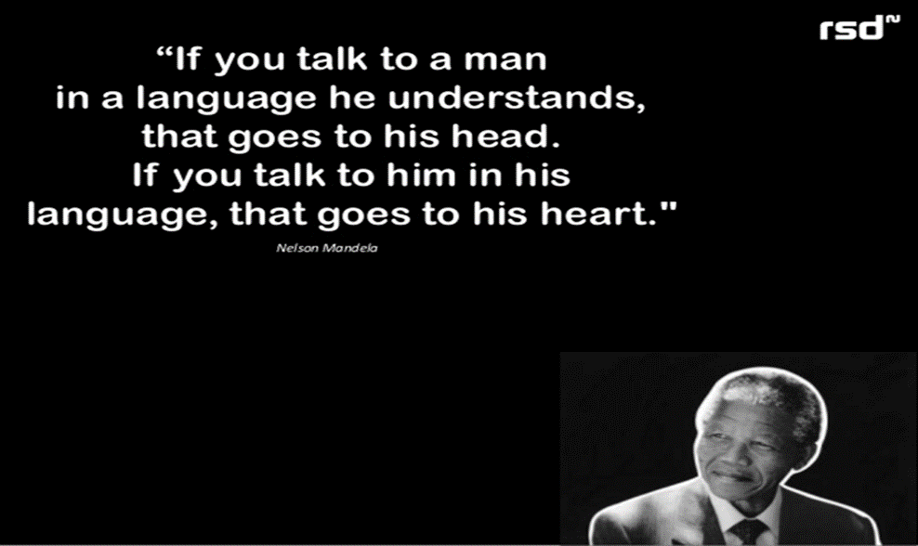
Stella: The Place and Practices of
Code-Meshing in Academic Writing
The
Dear Parents
Project
Notes:
Stella: academic code-meshing continued
The Dear Parents Project

Slide 36
Sarah: Developing Strategies for Tutoring Code-Meshing

Slide 37
References
Baugh, J. (2000). Beyond Ebonics: Linguistic pride and racial prejudice. New York: Oxford University Press.
Curriculum review committee final report (2016, Jan 13). Retrieved from https://www.rochester.edu/college/curriculum-report/
Calhoun, Adam J. (2016, February 15). Punctuation in novels. [Blog. Medium.com]. Retrieved from https://medium.com/@neuroecology/punctuation-in-novels- 8f316d542ec4#.24it9xdqf
Dryer, D. B., Bowden, D., Brunk-Chavez, B., Harrington, S., Halbritter, B., & Yancey, K. B. (2014). Revising FYC outcomes for a multimodal, digitally composed world: The WPA outcomes statement for first-year composition (version 3.0). WPA: Writing Program Administration, 38(1), 129-148.
Grosjean, F (2012, Sept 19). How many are we? On the difficulty of counting people who are bilingual [Web log post]. Retrieved from https://www.psychologytoday.com/blog/life-bilingual/201209/how-many-are-we
Institute of International Education (IIE) (2016). Infographs. Retrieved from
http://www.iie.org/Research-and-Publications/Open-Doors/Data/Infographics#.WMoc5me1sZY
Moss, B. J. & Walters, K. (1993). Rethinking diversity: Axes of difference in the writing classroom. In L. Odell (Ed.) Theory and practice in the teaching of writing: Rethinking the discipline (pp. 132-185). Southern Illinois University Press.
National Council of Teachers of English. (1974). Resolution on the students’ right to their own language. Retrieved from http://www.ncte.org/positions/statements/righttoownlanguage.
Palacas, A. L. (1989). Parentheticals and personal voice. Written Communication, 6(4), 506-527.
Pollock, D., & Van Reken, R. (2010). Third culture kids: Growing up among worlds. Nicholas Brealey Publishing.
Pre-major advising orientation [ppt]. Retrieved from http://www.rochester.edu/college/advising/resources.html
Risner, D. (2014). Gender problems in Western theatrical dance: Little girls, big sissies & the 'Baryshnikov Complex'. International Journal of Education & the Arts, 15(10).
Shafer, G. (2007). Dialects, gender, and the writing class. Teaching English in the Two Year College, 35(2), 169-177.
http://www.cc.com/video-clips/qvrhhj/key-and-peele-phone-call
http://www.ted.com/talks/jamila_lyiscott_3_ways_to_speak_english

Slide 38
2017 CCCC Code-Meshing Presentation
Please email us to continue this conversation and give us feedback.
  How well did this presentation help you to understand the usefulness of code-meshing as a pedagogical tool?
  How well did this presentation help you to think about how you might incorporate code-meshing into your writing classes?
  Is there anything we didn’t cover that you wish we had? Suggestions?
Whitney Gegg-harrison: whitney.gegg-harrison@rochester.edu
Sarah Lemade: slamade@u.rochester.edu
Stella Wang: stella.wang@rochester.edu
Suzanne Woodring: swoodring602@yahoo.com

Slide 39
Other presentations of interest
  Thursday 3:15-4:30 pm: D.19 Cultivating STEM-writing through diagnostic assessment, genre analysis, and writing center (A106)
  Friday 8:00-9:15 am: F.05 What linguistics can offer the composition teacher (F151)
  Friday 6:30-7:30 pm: FSIG.12 Linguistics, Language, and Writing Standing Group Business Meeting (B119)

