Slide 1
Code-Meshing:
Pedagogical Affordances and Challenges in
First-Year College Writing Classrooms
WHITNEY GEGG-HARRISON, SARAH LAMADE, STELLA WANG, SUZANNE WOODRING
WRITING, SPEAKING, AND ARGUMENT PROGRAM
UNIVERSITY OF ROCHESTER
SUNY Council on Writing Conference
Albany, New York
March 5, 2016
Notes:
Title slide: Intro

Slide 2
What is code-meshing?
Controversy: the relationship between code-meshing and code-switching?
Notes:
Stella: What is code-meshing? Controversy and our tentative research-based position

Slide 3
What is code-meshing?
Controversy: the relationship between code-meshing and code-switching?
Definitions:
code-switching
code-meshing
Notes:
Stella: What is code-meshing? Controversy and our tentative research-based position

Slide 4
What is code-meshing?
Controversy: the relationship between code-meshing and code-switching?
Definitions:
code-switching
    shifts between multiple languages, varieties, or registers
Notes:
Stella: What is code-meshing? Controversy and our tentative research-based position

Slide 5
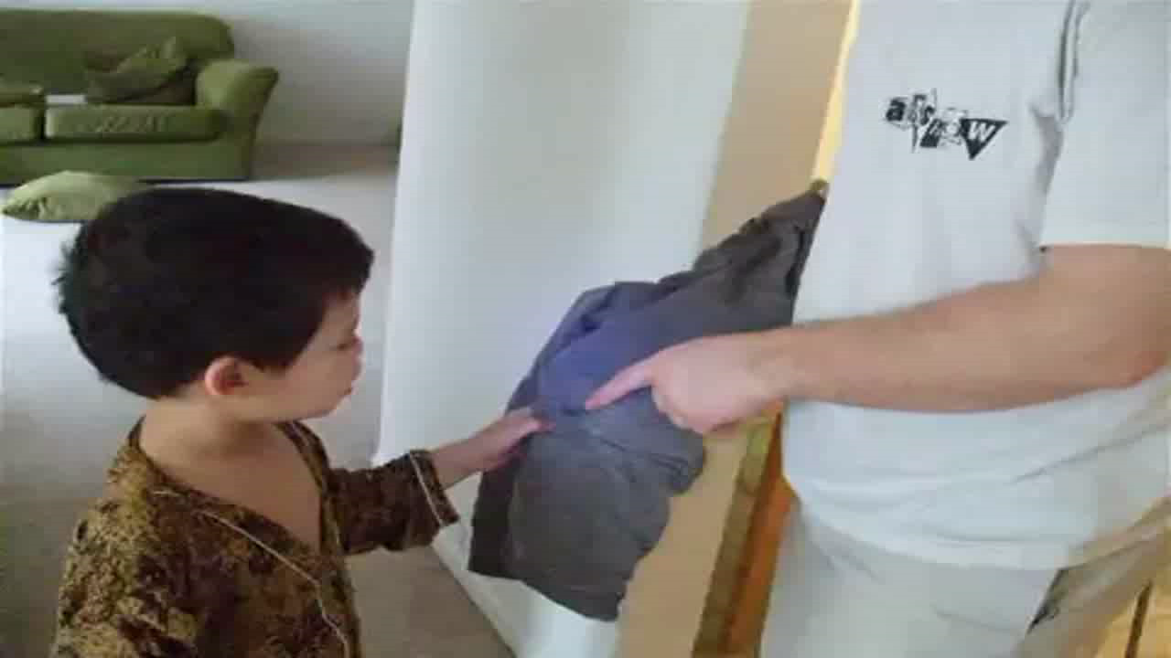
Code-Switching: between INDONESIAN, ENGLISH, AND FRENCH
Notes:
Stella: What is code-meshing? The multilingual child/Code-switching video

Slide 6
What is code-meshing?
Controversy: the relationship between code-meshing and code-switching?
Definitions:
code-switching
    shifts between multiple languages, varieties, or registers
code-meshing
    blends languages or local varieties with a dominant language
    tends to be a purposeful, rhetorical strategy
Notes:
Stella: What is code-meshing? Controversy and our tentative research-based position

Slide 7
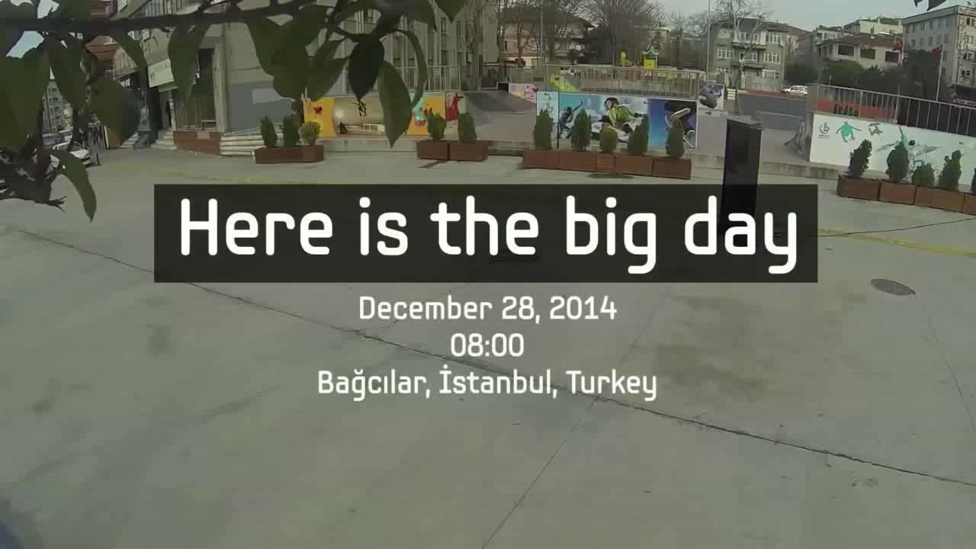
Code-Meshing: blending SIGN LANGUAGE AND WRITTEN ENGLISH
Hearing Hands
Notes:
Stella: What is code-meshing? Hearing Hands/Code-meshing video

Slide 8
What is code-meshing?
Our tentative position:
Notes:
Stella: What is code-meshing? Closing Slide

Slide 9
What is code-meshing?
Our tentative position:
    Both code-switching and code-meshing can involve multiple local and global languages
Notes:
Stella: What is code-meshing? Closing Slide

Slide 10
What is code-meshing?
Our tentative position:
    Both code-switching and code-meshing can involve multiple local and global languages
    Code-meshing is a deliberate, rhetorical move
    Code-meshing is highly relevent to writing and writing pedagogy
Notes:
Stella: What is code-meshing? Closing Slide

Slide 11
Why code-mesh?
To make a point or strengthen it
Notes:
Suzanne: Why code-meshing? Bullet 1

Slide 12
Why code-mesh?
To make a point or strengthen it
To celebrate ones’ own diverse linguistic and cultural identity
Notes:
Suzanne: Why code-meshing? Bullet 2

Slide 13
Why code-mesh?
To make a point or strengthen it
To celebrate ones’ own diverse linguistic and cultural identity
To take risks with using particular linguistic features - challenge initial assumptions about ‘good’ and ‘bad’ writing
Notes:
Suzanne: Why code-mesh? Bullet 3

Slide 14
Why teach code-meshing?
We can help students think about:
The value of their own linguistic resources
Audience, purpose, and genre in relation to the choices available to them as writers
Notes:
Whitney: Why teach code-meshing? Bullet 1

Slide 15
Why teach code-meshing?
We can help students think about:
The value of their own linguistic resources
Audience, purpose, and genre in relation to the choices available to them as writers
The social, political, and cultural features of spoken and written language (Safer, 2007)
Their perceptions of race and power and how these are connected to linguistic choices (Baugh, 2000)
Notes:
Whitney: Why teach code-meshing? Bullet 1

Slide 16
How do we teach code-meshing?
General Principles
Notes:
Stella: How do we teach code-meshing: Opening slide

Slide 17
How do we teach code-meshing?
General Principles
We encourage students to explore their own language resources and experiment with code-meshing in free writing and early drafts.
Notes:
Bullet 1: Whitney - image of multilingual notes/freewriting/World Englishes

Slide 18
How do we teach code-meshing?
General Principles
We encourage students to explore their own language resources and experiment with code-meshing in free writing and early drafts.
We teach elements of Standard English through code-meshing examples because in order to mesh English and another language, students must know the rules for both languages.
Notes:
Bullet 2: Stella

Slide 19
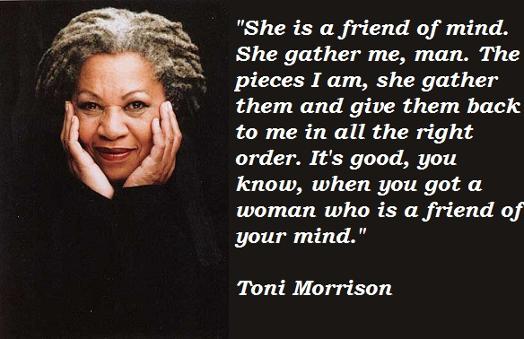
Teaching Standard English through Code-Meshing Examples
“Of course everyone thought I was the worst daughter ever. My tia and our neighbors kept saying, Hija, she’s your mother, she’s dying, but I wouldn’t listen. When I caught her hand a door opened. And I wasn’t about to turn my back on it.
But God, how we fought! Sick or not, dying or not, my mother wasn’t going to go down easily. She wasn’t una pendeja….”
Junot Díaz
Notes:
Bullet 2: Stella - beloved quote and Diaz quote

Slide 20
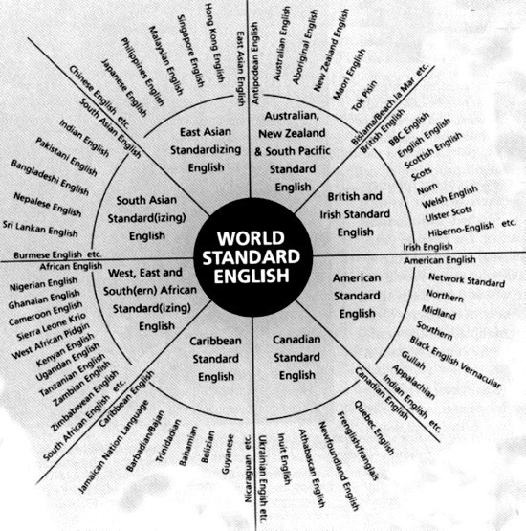
Teaching Standard English through Code-Meshing Examples
Yale Grammatical Diversity Project
1) I ain't never been drunk.
'I've never been drunk.'
(Alabama English; Feagin 1979)
2) Nobody ain't doin' nothing' wrong.
'Nobody is doing anything wrong.'
(West Texas English; Foreman 1999)
3) I don't never have no problems.
'I don't ever have any problems.'
(African American English; Green 2002)
Notes:
Bullet 2: Stella - yale project

Slide 21
How do we teach code-meshing?
General Principles
We encourage students to explore their own language resources and experiment with code-meshing in free writing and early drafts.
We teach elements of Standard English through code-meshing examples because in order to mesh English and another language, students must know the rules for both languages.
We use real examples of code-meshing to explore issues related to biases and assumptions about individuals and groups of people who speak a particular language or dialect in a certain context.
Notes:
Bullet 3: Suzanne

Slide 22

Key & Peele: Phone Call
Notes:
Bullet 3: Suzanne: Key & Peele

Slide 23
How do we teach code-meshing?
General Principles
We encourage students to explore their own language resources and experiment with code-meshing in free writing and early drafts.
We teach elements of Standard English through code-meshing examples because in order to mesh English and another language, students must know the rules for both languages
We use real examples of code-meshing to explore issues related to biases and assumptions about individuals and groups of people who speak a particular language or dialect in a certain context.
We support students interested in code-meshing opportunities, especially in understanding their advantages, risks, and challenges.
Notes:
Bullet 4: Sarah -

Slide 24
How do we teach code-meshing?
Specific Approaches
We design pilot lessons and writing assignments to support students’ investigations of how code-meshing occurs within and beyond the writing classroom:
Notes:
Whitney: How do we teaching code-meshing? Specific Approaches 1

Slide 25
How do we teach code-meshing?
Specific Approaches
We design pilot lessons and writing assignments to support students’ investigations of how code-meshing occurs within and beyond the writing classroom:
  Code-meshing as something that arises organically in the classroom:
    courses centered on language
    courses centered on culture
Notes:
Whitney: How do we teaching code-meshing? Specific Approaches 2

Slide 26
How do we teach code-meshing?
Specific Approaches
We design pilot lessons and writing assignments to support students’ investigations of how code-meshing occurs within and beyond the writing classroom:
  Code-meshing as something that arises organically in the classroom:
    courses centered on language
    courses centered on culture
  Code-meshing as a unit
    an integral part of the research writing unit
    applicable to a wide range of theme-based writing courses
Notes:
Whitney: How do we teaching code-meshing? Specific Approaches 3

Slide 27
How do we teach code-meshing?
Specific Approaches
We design pilot lessons and writing assignments to support students’ investigations of how code-meshing occurs within and beyond the writing classroom:
  Code-meshing as something that arises organically in the classroom:
    courses centered on language
    courses centered on culture
  Code-meshing as a unit
    an integral part of the research writing unit
    applicable to a wide range of theme-based writing courses
  Code-meshing in 1-on-1 tutoring contexts
Notes:
Whitney: How do we teaching code-meshing? Specific Approaches 4

Slide 28
Whitney’s class: Language as a Window into the Mind
language as “object of study” and as “playground”
  explore connections between language & thought and language & culture
  “play” with mixing different registers, genres, etc.
  think deeply about impact of particular linguistic choices
Notes:
Whitney’s class 4

Slide 29
Whitney’s class: Language as a Window into the Mind
language as “object of study” and as “playground”
  explore connections between language & thought and language & culture
  “play” with mixing different registers, genres, etc.
  think deeply about impact of particular linguistic choices
my focus: language/grammar as “tools for creating and shaping meaning”
  audience, purpose, genre: different tools for different jobs
  choices: every choice matters, influences the final “job” the writing can do
Notes:
Whitney’s class 4

Slide 30
Whitney’s class: Language as a Window into the Mind
Example Assignment: “Untranslatables”
(what makes a text hard to translate?)
  translation across languages? registers? cultures? genres?
  develop arguments relating to author’s intention as reflected through linguistic choices
Notes:
Whitney’s class 5: example assignment

Slide 31
Whitney’s class: Language as a Window into the Mind
Example Assignment: “Untranslatables”
(what makes a text hard to translate?)
  translation across languages? registers? cultures? genres?
  develop arguments relating to author’s intention as reflected through linguistic choices
More about developing formal writing assignments on issues relating to linguistic choices and code-switching in my group session!
Notes:
Whitney’s class 6 “more in my group session!”

Slide 32
Suzanne’s class: Culture and Learning
A focus on culture
  Different values
  Different needs
  Different approaches to teaching and learning
Notes:
Examples of ‘good writing’ as well as ‘bad writing’
‘I’m really bad at writing’ - based on prior writing experiences
complex sentence structures and big words make good writing
For students where English is not their first language - leave native language at the door, no use for native language or dialect in the classroom
Their audience is the teacher, the one grading
Audience = purpose; if they aren’t writing to a real audience, then there is no real purpose
Course content relates to the differences in learning between cultures - some examples, some expect children to learn through imitation, so focus on explicit instruction
Different cultures value aspects of intelligence to varying degrees or intelligence does not carry a universal definition
Something about different needs (this transitions into the differing needs of different audiences)
Then something about how different audiences have different needs
Example assignment: Writing for Different Audiences (4 parts)
Tell 3 different audiences about your research topic (after they’ve done some research)
Come up with a scenario (and define your purpose) - imagine you had to put 2 of your audiences in the same room and still make your point clear to all - now the task is that much more difficult because you have to meet the needs of each audience and maybe even address the point for why they are in the same room (in your writing)
Write about your topic again, this time making sure you are meeting the needs of your new audience (*some students choose to code-mesh and others do not - make the point here about not making code-meshing mandatory, but giving them the option).
Peer Review - Is the purpose clear? Has the writer made reasonable linguistic choices?

Slide 33
Suzanne’s class: Culture and Learning
A focus on culture
  Different values
  Different needs
  Different approaches to teaching and learning
Student assumptions
  Values - ‘Good’ versus ‘bad’ writing
  Need - purpose of writing assignments and audience
  Approach – skills needed for a particular writing assignment
Notes:
Examples of ‘good writing’ as well as ‘bad writing’
‘I’m really bad at writing’ - based on prior writing experiences
complex sentence structures and big words make good writing
For students where English is not their first language - leave native language at the door, no use for native language or dialect in the classroom
Their audience is the teacher, the one grading
Audience = purpose; if they aren’t writing to a real audience, then there is no real purpose
Course content relates to the differences in learning between cultures - some examples, some expect children to learn through imitation, so focus on explicit instruction
Different cultures value aspects of intelligence to varying degrees or intelligence does not carry a universal definition
Something about different needs (this transitions into the differing needs of different audiences)
Then something about how different audiences have different needs
Example assignment: Writing for Different Audiences (4 parts)
Tell 3 different audiences about your research topic (after they’ve done some research)
Come up with a scenario (and define your purpose) - imagine you had to put 2 of your audiences in the same room and still make your point clear to all - now the task is that much more difficult because you have to meet the needs of each audience and maybe even address the point for why they are in the same room (in your writing)
Write about your topic again, this time making sure you are meeting the needs of your new audience (*some students choose to code-mesh and others do not - make the point here about not making code-meshing mandatory, but giving them the option).
Peer Review - Is the purpose clear? Has the writer made reasonable linguistic choices?

Slide 34
Suzanne’s class: Culture and Learning
Example assignments:
Code-meshing for audience and purpose
Notes:
Examples of ‘good writing’ as well as ‘bad writing’
‘I’m really bad at writing’ - based on prior writing experiences
complex sentence structures and big words make good writing
For students where English is not their first language - leave native language at the door, no use for native language or dialect in the classroom
Their audience is the teacher, the one grading
Audience = purpose; if they aren’t writing to a real audience, then there is no real purpose
Course content relates to the differences in learning between cultures - some examples, some expect children to learn through imitation, so focus on explicit instruction
Different cultures value aspects of intelligence to varying degrees or intelligence does not carry a universal definition
Something about different needs (this transitions into the differing needs of different audiences)
Then something about how different audiences have different needs
Example assignment: Writing for Different Audiences (4 parts)
Tell 3 different audiences about your research topic (after they’ve done some research)
Come up with a scenario (and define your purpose) - imagine you had to put 2 of your audiences in the same room and still make your point clear to all - now the task is that much more difficult because you have to meet the needs of each audience and maybe even address the point for why they are in the same room (in your writing)
Write about your topic again, this time making sure you are meeting the needs of your new audience (*some students choose to code-mesh and others do not - make the point here about not making code-meshing mandatory, but giving them the option).
Peer Review - Is the purpose clear? Has the writer made reasonable linguistic choices?

Slide 35
Suzanne’s class: Culture and Learning
Example assignments:
Code-meshing for audience and purpose
  “Considering Audience” - addresses the significance of audience, purpose, authorial voice, grammar, and overall ‘effective’ communication.
Notes:
Examples of ‘good writing’ as well as ‘bad writing’
‘I’m really bad at writing’ - based on prior writing experiences
complex sentence structures and big words make good writing
For students where English is not their first language - leave native language at the door, no use for native language or dialect in the classroom
Their audience is the teacher, the one grading
Audience = purpose; if they aren’t writing to a real audience, then there is no real purpose
Course content relates to the differences in learning between cultures - some examples, some expect children to learn through imitation, so focus on explicit instruction
Different cultures value aspects of intelligence to varying degrees or intelligence does not carry a universal definition
Something about different needs (this transitions into the differing needs of different audiences)
Then something about how different audiences have different needs
Example assignment: Writing for Different Audiences (4 parts)
Tell 3 different audiences about your research topic (after they’ve done some research)
Come up with a scenario (and define your purpose) - imagine you had to put 2 of your audiences in the same room and still make your point clear to all - now the task is that much more difficult because you have to meet the needs of each audience and maybe even address the point for why they are in the same room (in your writing)
Write about your topic again, this time making sure you are meeting the needs of your new audience (*some students choose to code-mesh and others do not - make the point here about not making code-meshing mandatory, but giving them the option).
Peer Review - Is the purpose clear? Has the writer made reasonable linguistic choices?

Slide 36
Suzanne’s class: Culture and Learning
Example assignments:
Code-meshing for audience and purpose
  “Considering Audience” - addresses the significance of audience, purpose, authorial voice, grammar, and overall ‘effective’ communication.
  “Writing for Different Audiences” - addresses context and situation, audience, communicative goals, and the benefits and disadvantages of linguistic choices
Notes:
Examples of ‘good writing’ as well as ‘bad writing’
‘I’m really bad at writing’ - based on prior writing experiences
complex sentence structures and big words make good writing
For students where English is not their first language - leave native language at the door, no use for native language or dialect in the classroom
Their audience is the teacher, the one grading
Audience = purpose; if they aren’t writing to a real audience, then there is no real purpose
Course content relates to the differences in learning between cultures - some examples, some expect children to learn through imitation, so focus on explicit instruction
Different cultures value aspects of intelligence to varying degrees or intelligence does not carry a universal definition
Something about different needs (this transitions into the differing needs of different audiences)
Then something about how different audiences have different needs
Example assignment: Writing for Different Audiences (4 parts)
Tell 3 different audiences about your research topic (after they’ve done some research)
Come up with a scenario (and define your purpose) - imagine you had to put 2 of your audiences in the same room and still make your point clear to all - now the task is that much more difficult because you have to meet the needs of each audience and maybe even address the point for why they are in the same room (in your writing)
Write about your topic again, this time making sure you are meeting the needs of your new audience (*some students choose to code-mesh and others do not - make the point here about not making code-meshing mandatory, but giving them the option).
Peer Review - Is the purpose clear? Has the writer made reasonable linguistic choices?

Slide 37
Suzanne’s class: Culture and Learning
Example assignments:
Code-meshing for audience and purpose
  “Considering Audience” - addresses the significance of audience, purpose, authorial voice, grammar, and overall ‘effective’ communication.
  “Writing for Different Audiences” - addresses context and situation, audience, communicative goals, and the benefits and disadvantages of linguistic choices
  Peer Review - Is the writer’s purpose clear? Has the writer made appropriate linguistic choices?
Notes:
Examples of ‘good writing’ as well as ‘bad writing’
‘I’m really bad at writing’ - based on prior writing experiences
complex sentence structures and big words make good writing
For students where English is not their first language - leave native language at the door, no use for native language or dialect in the classroom
Their audience is the teacher, the one grading
Audience = purpose; if they aren’t writing to a real audience, then there is no real purpose
Course content relates to the differences in learning between cultures - some examples, some expect children to learn through imitation, so focus on explicit instruction
Different cultures value aspects of intelligence to varying degrees or intelligence does not carry a universal definition
Something about different needs (this transitions into the differing needs of different audiences)
Then something about how different audiences have different needs
Example assignment: Writing for Different Audiences (4 parts)
Tell 3 different audiences about your research topic (after they’ve done some research)
Come up with a scenario (and define your purpose) - imagine you had to put 2 of your audiences in the same room and still make your point clear to all - now the task is that much more difficult because you have to meet the needs of each audience and maybe even address the point for why they are in the same room (in your writing)
Write about your topic again, this time making sure you are meeting the needs of your new audience (*some students choose to code-mesh and others do not - make the point here about not making code-meshing mandatory, but giving them the option).
Peer Review - Is the purpose clear? Has the writer made reasonable linguistic choices?

Slide 38
Suzanne’s class: Culture and Learning
Example assignments:
Code-meshing for audience and purpose
  “Considering Audience” - addresses the significance of audience, purpose, authorial voice, grammar, and overall ‘effective’ communication.
  “Writing for Different Audiences” - addresses context and situation, audience, communicative goals, and the benefits and disadvantages of linguistic choices
  Peer Review - Is the writer’s purpose clear? Has the writer made appropriate linguistic choices?
  Code-meshing as a choice, not a requirement
Notes:
Examples of ‘good writing’ as well as ‘bad writing’
‘I’m really bad at writing’ - based on prior writing experiences
complex sentence structures and big words make good writing
For students where English is not their first language - leave native language at the door, no use for native language or dialect in the classroom
Their audience is the teacher, the one grading
Audience = purpose; if they aren’t writing to a real audience, then there is no real purpose
Course content relates to the differences in learning between cultures - some examples, some expect children to learn through imitation, so focus on explicit instruction
Different cultures value aspects of intelligence to varying degrees or intelligence does not carry a universal definition
Something about different needs (this transitions into the differing needs of different audiences)
Then something about how different audiences have different needs
Example assignment: Writing for Different Audiences (4 parts)
Tell 3 different audiences about your research topic (after they’ve done some research)
Come up with a scenario (and define your purpose) - imagine you had to put 2 of your audiences in the same room and still make your point clear to all - now the task is that much more difficult because you have to meet the needs of each audience and maybe even address the point for why they are in the same room (in your writing)
Write about your topic again, this time making sure you are meeting the needs of your new audience (*some students choose to code-mesh and others do not - make the point here about not making code-meshing mandatory, but giving them the option).
Peer Review - Is the purpose clear? Has the writer made reasonable linguistic choices?

Slide 39
Stella: The Code-Meshing Multimodal Project in the Research Writing Unit
An integral part of the final Research Project
Deliberate, mixed use of the writer’s linguistic resources as well as text, visuals, and sound to engage the targeted audience cognitively and emotionally
Heightened awareness of the audience and code-meshing for communication and argument
Notes:
Stella’s class 1: the code-meshing multimodel project

Slide 40
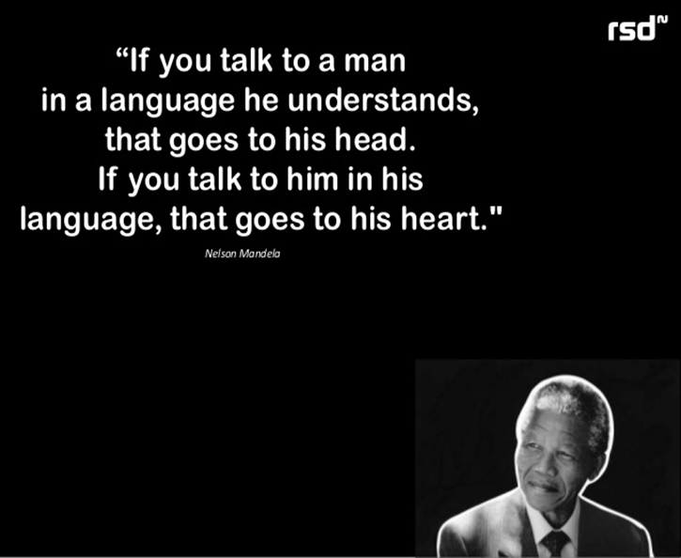
Stella: The Code-Meshing Multimodal Project in the Research Writing Unit
The Siri Project
Notes:
Stella’s class 2: The Siri Project

Slide 41
Sarah: Guiding Code-Meshing in Tutoring and 1-on-1 Support
Notes:
Sarah: Guiding code-meshing: opening slide

Slide 42
Sarah: Guiding Code-Meshing in Tutoring and 1-on-1 Support
Code-meshing must be a deliberate choice of the writer
Notes:
Sarah: Guiding code-meshing Bullet 2

Slide 43
Sarah: Guiding Code-Meshing in Tutoring and 1-on-1 Support
Code-meshing must be a deliberate choice of the writer
Tutors should be trained in code-meshing and code-meshing strategies
  Sensitivity to writer’s identity
  Awareness of different forms of code-meshing
    Multilingualism; dialect; register ; disciplinary conventions
Notes:
Sarah: Guiding code-meshing Bullet 2

Slide 44
Sarah: Guiding Code-Meshing in Tutoring and 1-on-1 Support
Code-meshing must be a deliberate choice of the writer
Tutors should be trained in code-meshing and code-meshing strategies
  Sensitivity to writer’s identity
  Awareness of different forms of code-meshing
    Multilingualism; dialect; register ; disciplinary conventions
Anyone can code-mesh!
Notes:
Sarah: Guiding code-meshing Bullet 2

Slide 45

… a brief aside: Meshing Register and Voice
Palacas (1989): Parentheticals and Personal Voice
“...one clear source of voice is appositive and parenthetical structures…[which are] inserted into a sentence, interrupting its normal flow…”
visualization of punctuation in Blood Meridian by Cormac McCarthy (left) and in Absalom, Absalom! by William Faulkner (right), Calhoun 2016

Slide 46
Sarah: Guiding Code-Meshing in Tutoring and 1-on-1 Support
Some students may be familiar with code-meshing… many will not be.
Notes:
Sarah: Guiding code-meshing Bullet 3

Slide 47
Sarah: Guiding Code-Meshing in Tutoring and 1-on-1 Support
Some students may be familiar with code-meshing… many will not be.
Introduce code-meshing to students looking for help with:
  addressing a specific audience
  strengthening argument
  developing voice or style
Notes:
Sarah: Guiding code-meshing Bullet 3

Slide 48
Sarah: Strategies for Tutoring Code-Meshing
Notes:
Sarah: Tutoring strategies: opening slide

Slide 49
Sarah: Strategies for Tutoring Code-Meshing
asking questions
  what is your identity as the writer of this paper?
  how can you make it clear how you relate to this topic?
  who are your audiences? what are the expected ways of using language for writing to those audiences?
Notes:
Sarah: Tutoring strategies: Bullet 1

Slide 50
Sarah: Strategies for Tutoring Code-Meshing
role-playing and free writing
  student embodies their identity as the writer
  tutor takes the role of the intended audience
  tutor prompts student to explain an argument or passage:
        say this to me like you’re talking to someone from your hometown
        how would you explain this to an academic in your field?
        what if you were addressing a specific language community?
Notes:
Sarah: Tutoring strategies: Bullet 2

Slide 51
Sarah: Strategies for Tutoring Code-Meshing
identifying places in the paper for code-meshing
  climatic moments
      coming to a conclusion or making a point
      passages that are especially important for the audience to understand
  reinterpretation
      technical/complex/jargony passages that can be made clearer
      already prominent in academic writing
Notes:
Sarah: Tutoring strategies: Bullet 3

Slide 52
Sarah: Strategies for Tutoring Code-Meshing
identifying places for effective code-meshing
Reinterpretation in Academic Writing
    … homophobia arises from the need from males to rationalize their close attraction to other men. In this scheme men can only bond socially when homophobic attitudes and language accompany closeness, intimacy, and attraction in their social relationships with other men (think: Monday Night Football). In other words, cultural norms require that males profess an absolute repulsion for same-sex desire or attraction and to vocalize this disgust openly and repeatedly.
    Risner 2014
Notes:
Sarah: Tutoring strategies: Bullet 3

Slide 53
Sarah: Strategies for Tutoring Code-Meshing
identifying places in the paper for code-meshing
  climatic moments
      coming to a conclusion or making a point
      passages that are especially important for the audience to understand
  reinterpretation
      technical/complex/jargony passages that can be made clearer
      already prominent in academic writing
  shout outs and inside jokes
      allow writer to identify with specific audience or linguistic population
      establish rapport or solidarity with the audience
Notes:
Sarah: Tutoring strategies: Bullet 3

Slide 54
References and Code-Meshing Resources
Baugh, J. (2000). Beyond ebonics: Linguistic pride and racial prejudice. New York: Oxford University Press.
Calhoun, Adam J. (2016, February 15). Punctuation in novels. [Blog. Medium.com]. Retrieved from https://medium.com/@neuroecology/punctuation-in-novels- 8f316d542ec4#.24it9xdqf
Díaz, Junot. (2007). The brief wondrous life of Oscar Wao. New York: Riverhead Books.
Morrison, Toni. (1987). Beloved. New York: Knopf
Palacas, A. L. (1989). Parentheticals and personal voice. Written Communication, 6(4), 506-527.
Risner, D. (2014). Gender problems in Western theatrical dance: Little girls, big sissies & the 'Baryshnikov Complex'. International Journal of Education & the Arts, 15(10).
Shafer, G. (2007). Dialects, gender, and the writing class. Teaching English in the Two Year College, 35(2), 169-177.
http://www.cc.com/video-clips/qvrhhj/key-and-peele-phone-call
http://www.ted.com/talks/jamila_lyiscott_3_ways_to_speak_english
NPR Code Switch blog: http://www.npr.org/sections/codeswitch/2015/01/29/382437460/challenging-the-whiteness-of-public-radio
Yale Grammatical Diversity Project, English in North America: http://microsyntax.sites.yale.edu/
Notes:
-NPR code switch
such as… (Whitney)
-Key and Peele (Suzanne)
-Translated Shakespeare
-Performance Poetry Piece (Suzanne)
-Creative Writing & Academic Writing code-meshed pieces (Stella)

Slide 55
Facilitated Group Activities!
Sarah and Stella: analyzing code-meshed academic papers
Suzanne: in-class activities
Whitney: formal assignments/argumentative papers

Slide 56
Code-Meshing Workshop
Please give us feedback on the overall effectiveness of this workshop. If you thought it was ineffective/not useful, please explain why.
How well did this workshop help you to understand the usefulness of code-meshing as a pedagogical tool?
How well did this workshop help you to think about how you might incorporate code-meshing into your writing classes?
Is there anything we didn’t cover that you wish we had? Suggestions?

